Slide 1


SEIM ( ELK STACK )
Lalle mohamed
From 01/02/2023 to 01/06/2023
Professional supervisor :
Med Abdrahmane Tabou
University supervisor
Ahmed Sejad

Slide 2
Table of contents
01
02
03
Introduction
Rimatel
Siem
04
05
06
Siem tools
ELK Stack
conclusion

Slide 3
Introduction
3

Slide 4
RIMATEL
Made of team
Able to detect any problem and resolve it.
Founded in 2021
Provides
high quality services.
Marche 22
Launch of services.
Offers
24-hour service

Slide 5
SIEM
Identifies categories & analyses
Identify data breaches and send alerts
01
02
03
04
Collect data from sources
Normalize and aggregate the collected data

Slide 6





SIEM tools
ELK stack
Apache Metron
Siemonster
Prelude
OSSIM

Slide 7
ELK Stack | Apache Metron | SIEMonster | Prelude | OSSIM
Log files , Metrics, network traffic , host based data | Network and host based data | Network traffic and system logs | Network and host based data | Network and host based data
Highly Scalable | Scalable | Scalable | Scalable | Scalable
Large and active | Active | Active | Disactive | Active

Slide 8




ELK Stack

Slide 9
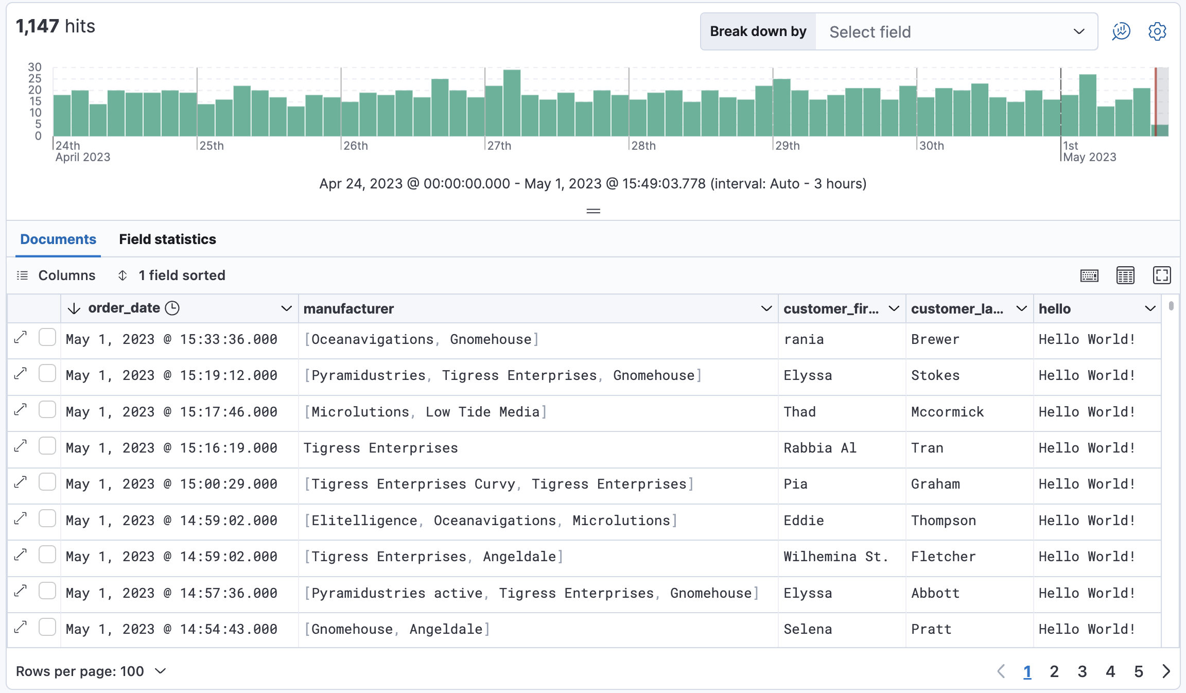
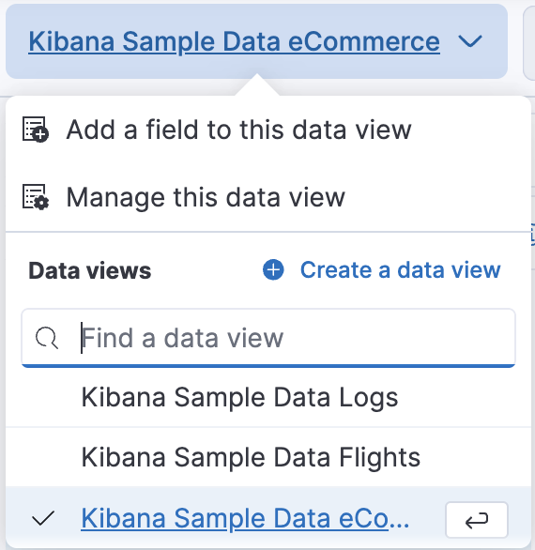
Discover

Slide 10
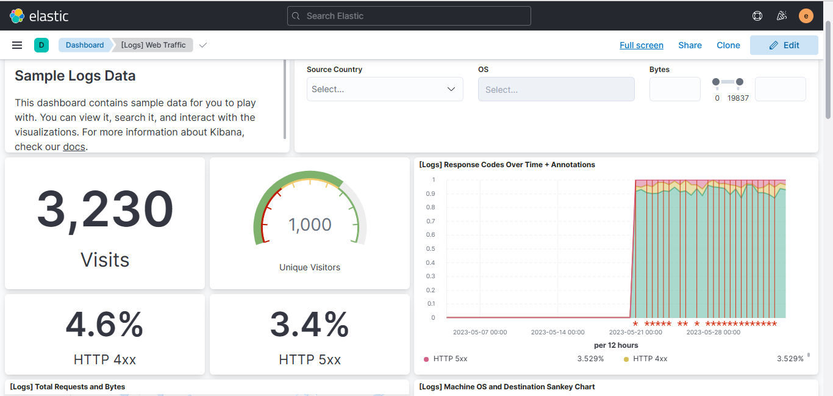
Dashboards

Slide 11
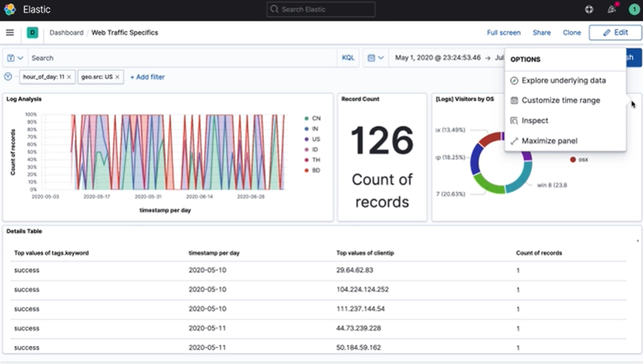

Slide 12
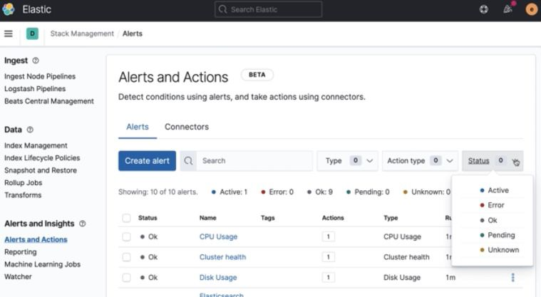
Alerts

Slide 13
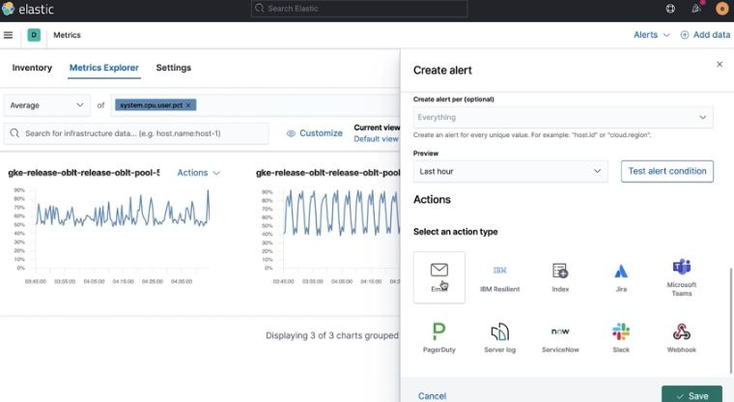

Slide 14
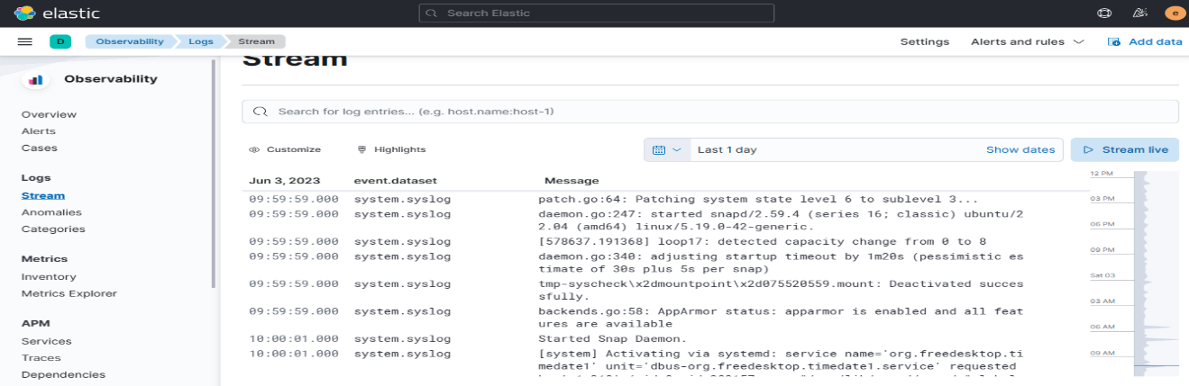
Logs

Slide 15
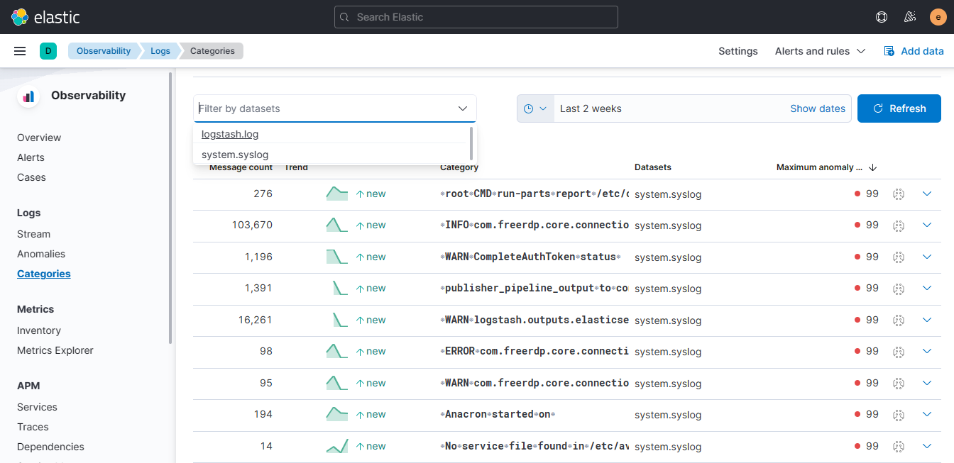

Slide 16
Conclusion and Perspectives

Slide 17
Thanks for listening ...

